Slide 1

Stock tracking
Using python

Slide 2
Table of contents
INTRODUCTION PG. 3
SETTING THE ENVIRONMENT PG. 4
REVIEW PYTHON PG. 5
ESTABLISHING CLASS PG. 6
ADDING A STOCK PG 7
LISTING ALL STOCKS PG 8
DAILY DATA PG 9
INHERITED CLASSES PG 10
UNIT TESTS PG 11
STOCK MENU PROGRAM PG.12
TEST CHART PG 13
IMPORTING DATA PG 14
IMPORTING DATA CHART DISPLAY PG 15
STOCKS IN GUI PG 16
IMPORTED STOCK HISTORY GUI PG 17
GUI STOCK REPORT PG 18
CAREER SKILLS DEVELOPED PG. 19
CONCLUSION PG. 20

Slide 3

INTRODUCTION
THIS PROJECT WILL SHOWCASE THE USE OF OBJECT-ORIENTED TECHNIQUES TO DEVELOP A STOCK TRACKING APPLICATION.
IT WILL INVOLVE PROCESSING HISTORICAL STOCK DATA AND GENERATING A PROFIT AND LOSS REPORT. USERS WILL BE ABLE TO SAVE AND RETRIEVE STOCK DATA. ADDITIONALLY, THE APPLICATION WILL DISPLAY STOCK TRENDS USING PYTHON LIBRARIES TO CREATE CHARTS.

Slide 4

SETTING THE ENVIRONMENT
FOR THE EXECUTION OF THIS PROJECT, I WILL BE UTILIZING ANACONDA, A PYTHON AND R DISTRIBUTION AS WELL AS A COMPREHENSIVE SET OF TOOLS FOR SOFTWARE DEVELOPMENT AND DATA SCIENCE. AFTER THE INSTALLATION OF ANACONDA, WE WILL EMPLOY THE SPYDER IDE, WHICH IS EXCLUSVELY TAILORED FOR PYTHON.

Slide 5
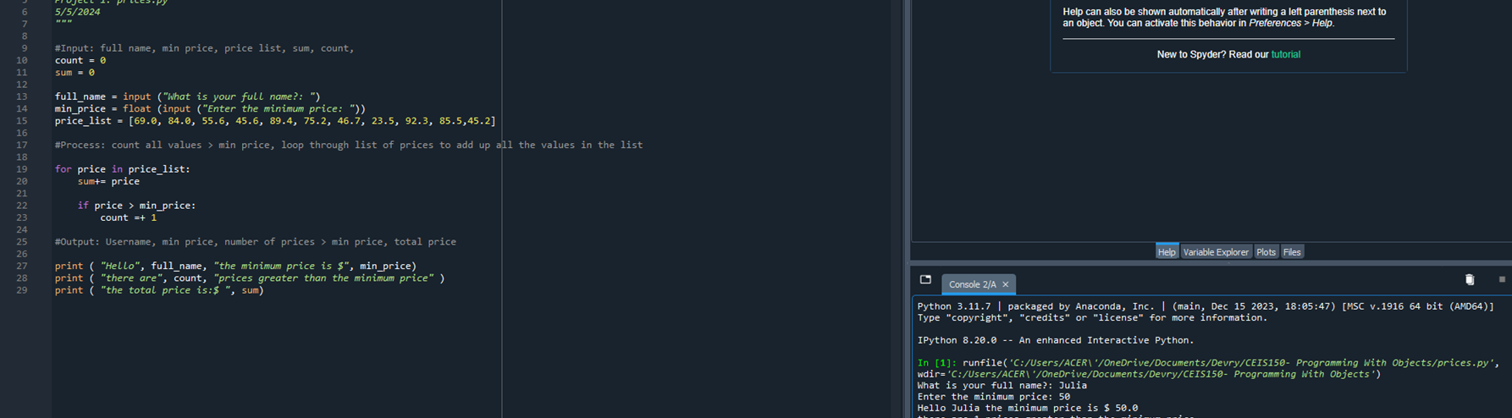
REVIEWING
PYTHON
PSEUDOCODE CODE:
initialize the count variable to 0
initialize the sum variable to 0
input full_name
input the min_price and convert it to float
create a list of prices example: price_list = [69.0, 71.0, 84.5, 91.0, 67.4, 81.2, 84.6, 58.8, 79.3, 101.2]
for price in price_list
add current price to sum
if price > min_price
increment count by 1
output "Hello",name,"the minimum price is ",min_price
output "There are ",count,"prices greater than the minimum price"
output "The total price is ",sum
FOR THIS PROGRAM, WE’RE USING PYTHON WITH OBJECTS. I WANT TO REVIEW PYTHON PROGRAMMING AND CREATE A PROGRAM THAT SHOWS A LIST OF CURRENT PRICES. USING PSEUDOCODE AS A GUIDE, I WILL CREATE A PROGRAM CALLED PRICES.PY. IN THIS PROGRAM, I WILL DISPLAY A LIST OF PRICES, I WILL ASK THE USER TO INPUT THEIR FULL NAME AND MINIMUM PRICE. THE PROGRAM WILL THEN FIND ALL PRICES GREATER THAN THE GIVEN MINIMUM PRICE.

Slide 6
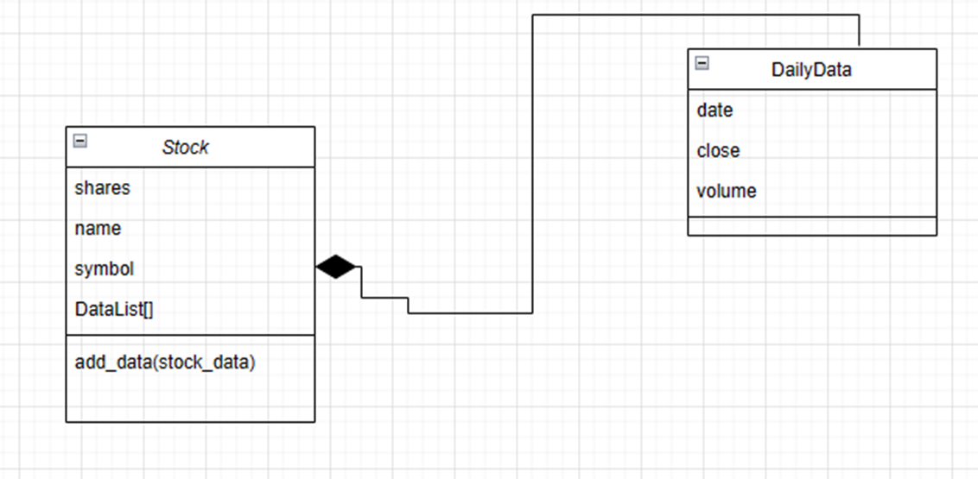
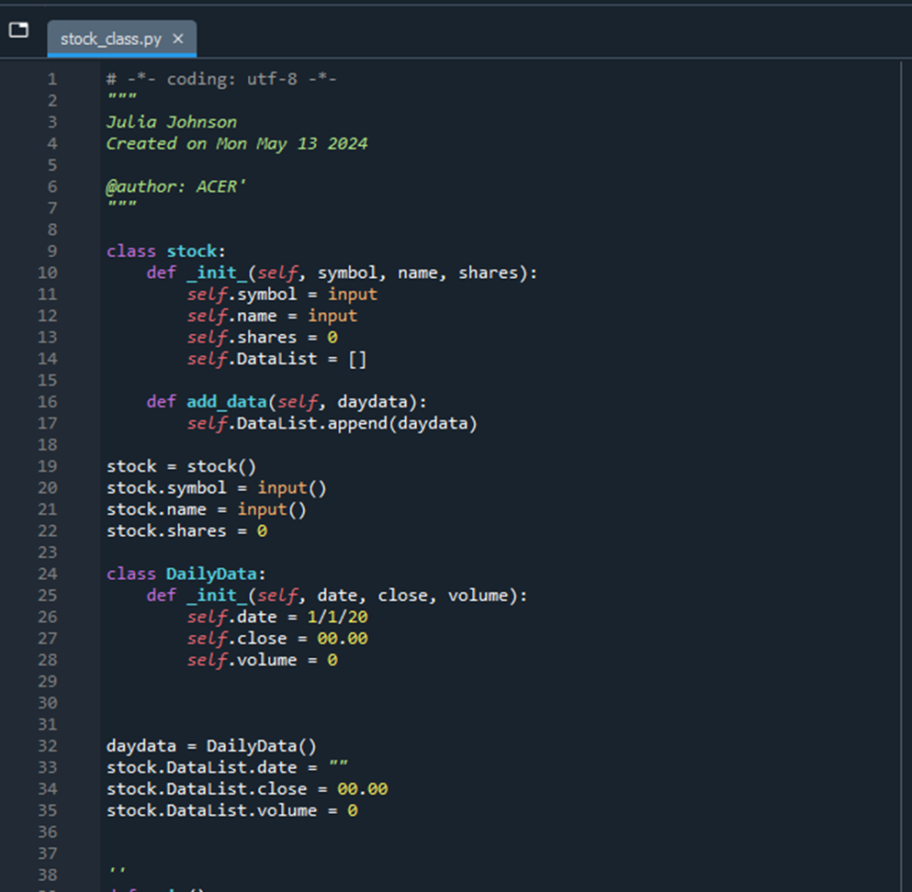
ESTABLISHING
CLASS
NOW IS THE FUN PART CREATING OUR STOCK TRACKER. IN THIS SECTION OF THE PROJECT WE WILL FOCUS ONCREATING THE CLASSES NEEDED TO WORK WITH OUR STOCKS AND HISTORICAL DATA. THESE CLASSES WILL BE THE FOUNDATION OF OUR PROGRAM.
TO START THIS PROCESS I WANT TO CREATE A DIAGRAM WE WILL ONLY BE USING TWO RELATED CLASSES TO KEEP TRACK OF OUR STOCK AND PRICE HISTORY DATA.
THE STOCK CLASS WILL HAVE PROPERTIES TO HANDLE THE SYMBOL WE WILL USE TO IDENTIFY THE STOCK, THE NAME OF THE COMPANY AND THE NUMBER OF SHARS WE OWN.
THE DAILYDATA CLASS WILL HAVE PROPERTIES TO HANDLE THE DATE, CLOSING PRICE FOR THE DAY AND VOLUME (NUMBER OF SHARES TRADED THAT DAY).

Slide 7
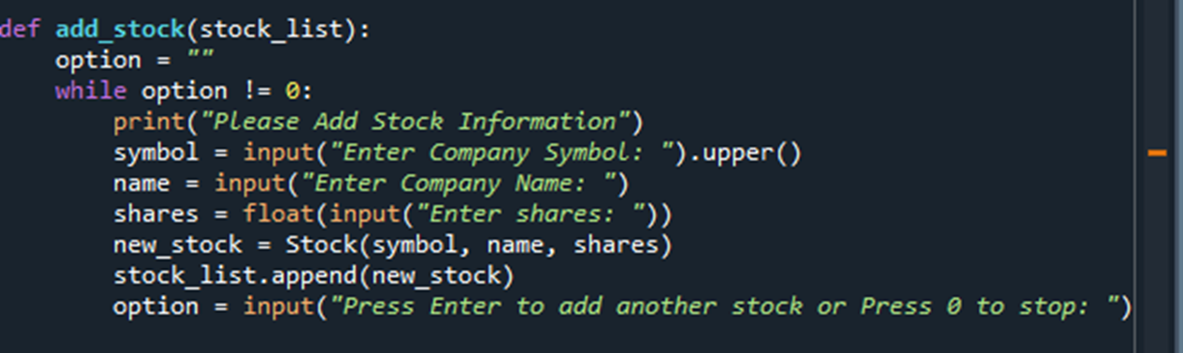
ADDING STOCK
WE WILL CREATE A STOCK MENU FOR THE USER INTERFACE. THE MENU WILL CONSIST OF 8 OPTIONS FOR THE USER TO CHOOSE FROM. 1. ADD STOCK, 2. DELETE STOCK, 3. LIST STOCK, 4. ADD DAILY STOCK DATA, 5. SHOW CHART, 6. INVESTOR TYPE, 7. LOAD DATA, 8. EXIT PROGRAM.
TO ADD FUNCTIONALITY TO THE MENU, WE START WITH CODE FOR ADD_STOCK. THIS ALLOWS THE USER TO INPUT STOCK’S SYMBOL, COMPANY NAME AND SHARES.

Slide 8
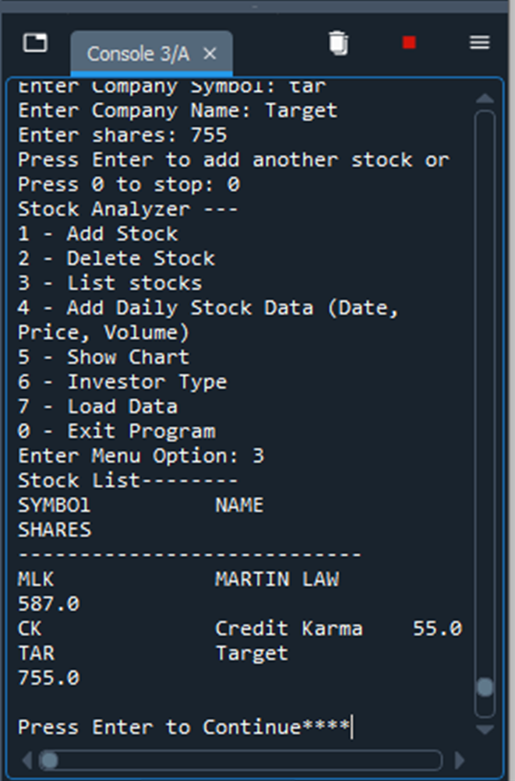
LISTING ALL STOCK
BY CREATING THE ADD STOCK OPTION THE USER WILL INPUT STOCK INFORMATION AND IT WILL BE PUT INTO OUR STOCK LIST.
NEXT, WE CREATE THE FUNCTIONALITY OF OUR LIST STOCKS SO THAT WE CAN DISPLAY THE STOCKS THAT WERE ENTERED. NOW WE ARE ABLE TO VIEW OUR LISTED STOCK UNDER OPTION 3 ON OUR STOCK MENU.
WE ALSO CREATED TH DELETE STOCK FROM OUR LIST USING THE POP() FUNCTION. WE WILL FIRST DISPLAY THE LIST OF STOCK. ONCE WE KNOW WHICH STOCK THEY WANT TO DELETE WE LOOP THROUGH THE STOCK_LIST TO FIND THE MATCHING STOCK AND USE THE POP() FUNCTION WITH THE INDEX OF THE ITEM TO REMOVE IT FROM THE LIST.

Slide 9
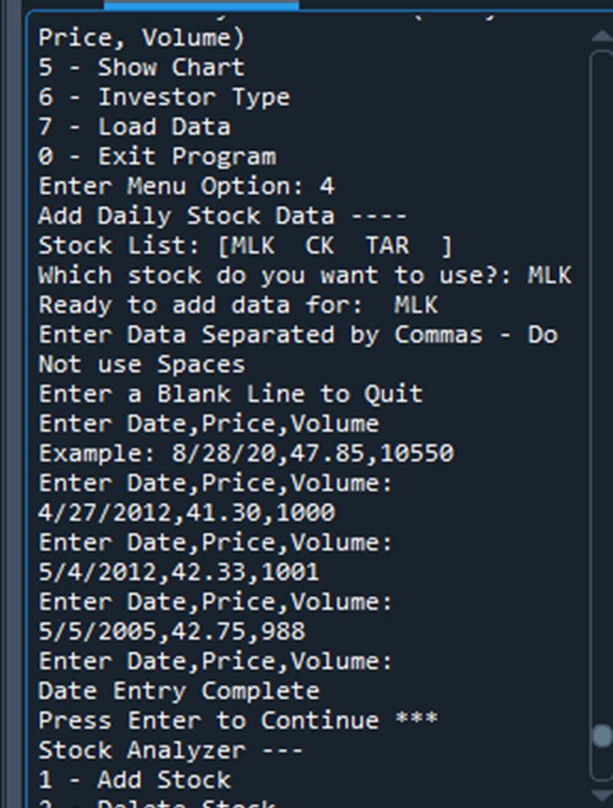
DAILY DATA
AT THIS POINT OF THE PROJECT, WE ARE NOW ABLE TO ADD, UPDATE AND DELETE STOCKS. NOW WE WANT OUR USER TO BE ABLE TO ADD HISTORICAL DATA FOR A STOCK.
WITH THE SAME CONCEPT AS THE DELETE STOCK FUNCTION. WE WANT TO DISPLAY THE LIST OF STOCKS THAT THE USER CAN SELECT FROM.
ONCE THE USER ENTERS THE STOCK, THEY WOULD LIKE TO ADD DATA TO. THE PROGRAM WILL LOOP THOUGH THE STOCK LIST TO FIND THE STOCK AND PROMPT THE USER TO ENTER STOCK’S DATE, CLOSING PRICE AND VOLUME.

Slide 10
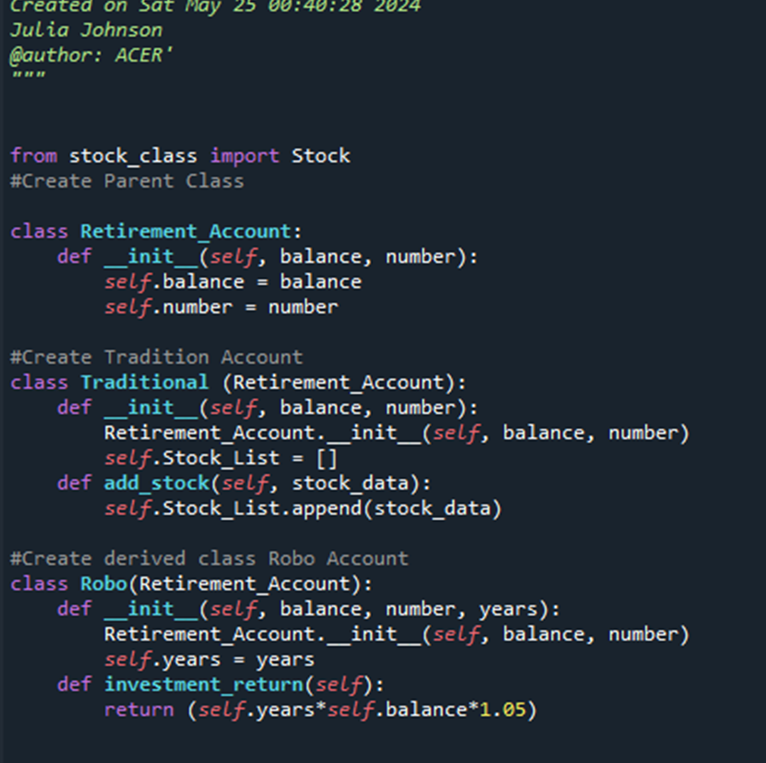
INHERITED CLASSES
WE WILL CREATE TWO INHERITANCE IN OUR STOCK PROGRAM OF RETIREMENT ACCOUNTS. THIS GIVES THE USER THE OPTION TO CHOOSE BETWEEN A TRADITIONAL RETIREMENT ACCOUNT OR AN AUTOMATIC ACCOUNT.
THE TRADITIONAL ACCOUNT WILL ALLOW THE USER TO CHOOSE TO INVEST IN SPECIFIC STOCKS.
THE AUTOMTIC ACCOUNT WIL INVEST THE ACCOUNT IN A FUND FOR A CERTAIN NUMBER OF YEARS

Slide 11
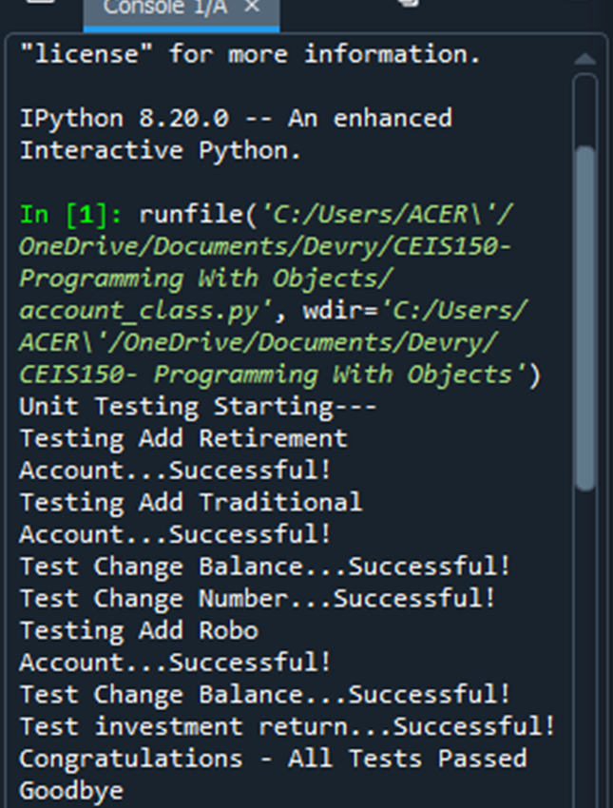
UNIT TESTS
WE WANT TO TEST THE PROGRAM TO ENSURE NO ISSUES. WHEN WE RUN THE TEST, IT WILL ATTEMPT TO CREATE A NEW STOCK AND ADD PRICE HISTORY TO THE STOCK.
THE TEST WILL ENSURE THAT THE PROGRAM WILL CHANGE THE STOCK SYMBOL., THE STOCK NAME AND CHANGE SHARES. IF THE CHANGE DID NOT OCCUR THE TEST PROGRAM WILL GIVE A REPORT SHOWING WHICH TESTS PASSES OR FAILED THEN GIVE US A SUMMARY OF THE LIST OF ERRORS THAT NEEDS TO BE FIXED.

Slide 12
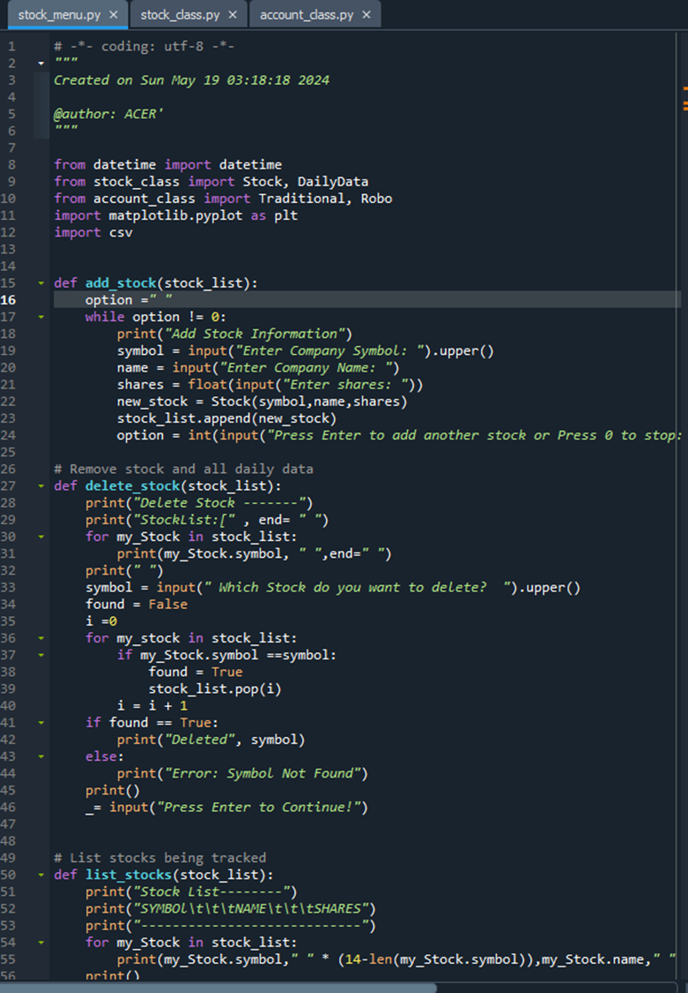
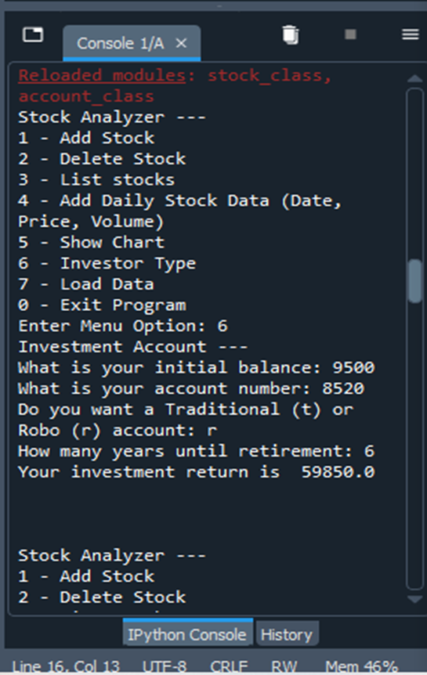
STOCK MENU PROGRAM

Slide 13
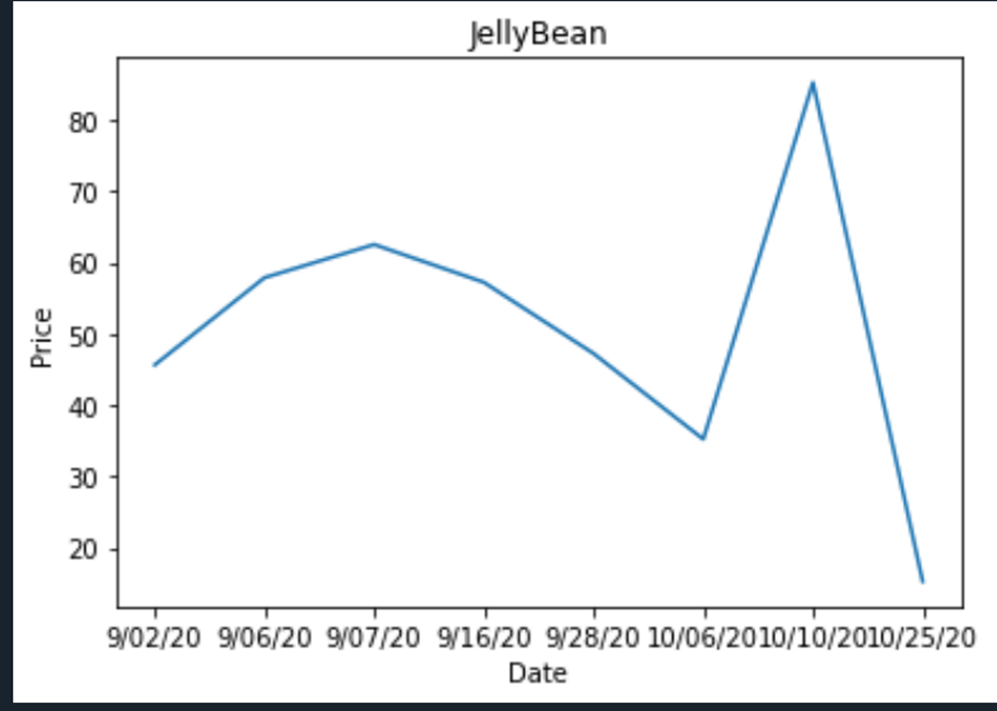
TEST CHART
WITH THE STOCK INPUT PROVIDED BY THE USER YOU CAN CREATE A CHART AS SHOWN

Slide 14
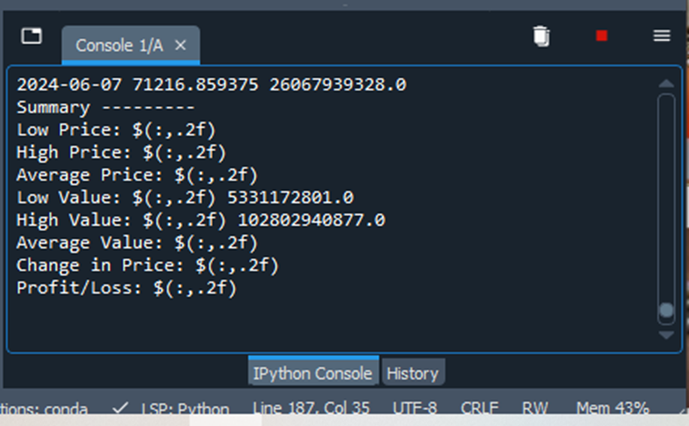
IMPORTING DATA
WE CAN USE THE CSV FORMAT TO EXCHANGE DATA. USING PYTHON’S CSV LIBRARY TO IMPLEMENT THE IMPORT FUNCTIONALITY.
BEFORE WRITING CODE TO CSV IMPORT. WE DOWNLOADED HISTORICAL STOCK DATA FROM YAHOO FINANCE.
THEN CREATED CODE UNDER OUR DISPLAY_REPORT (STOCK_LIST) IN OUR PROGRAM. WITH THE PROGRAM IT WAS ABLE TO PROVIDE USE WITH A SUMMARY OF THE STOCK

Slide 15
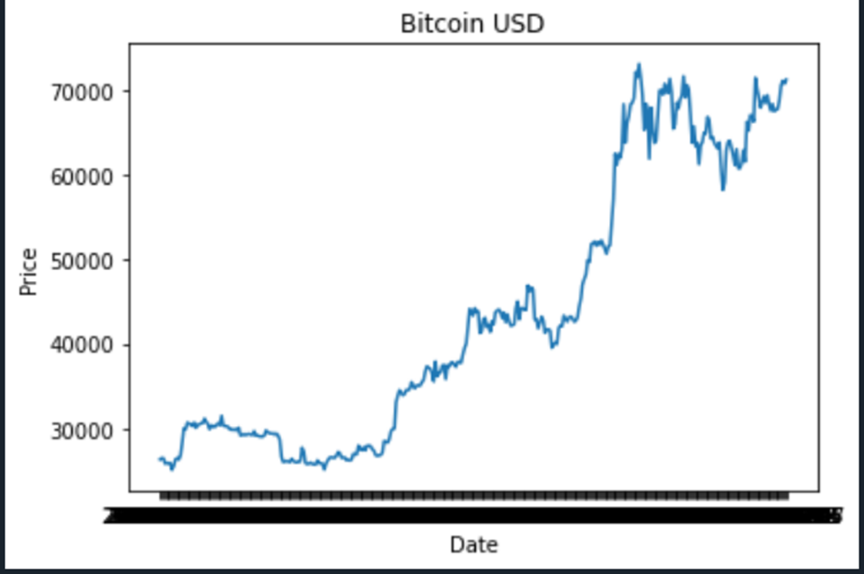
DATA CHART
NOW WITH THE SAME DATA WE HAVE IMPORTED WE ARE ABLE TO GRAPH THE DATA WHICH GIVES THE USER A BETTER PICTURE OF THE STOCKS TREND.

Slide 16
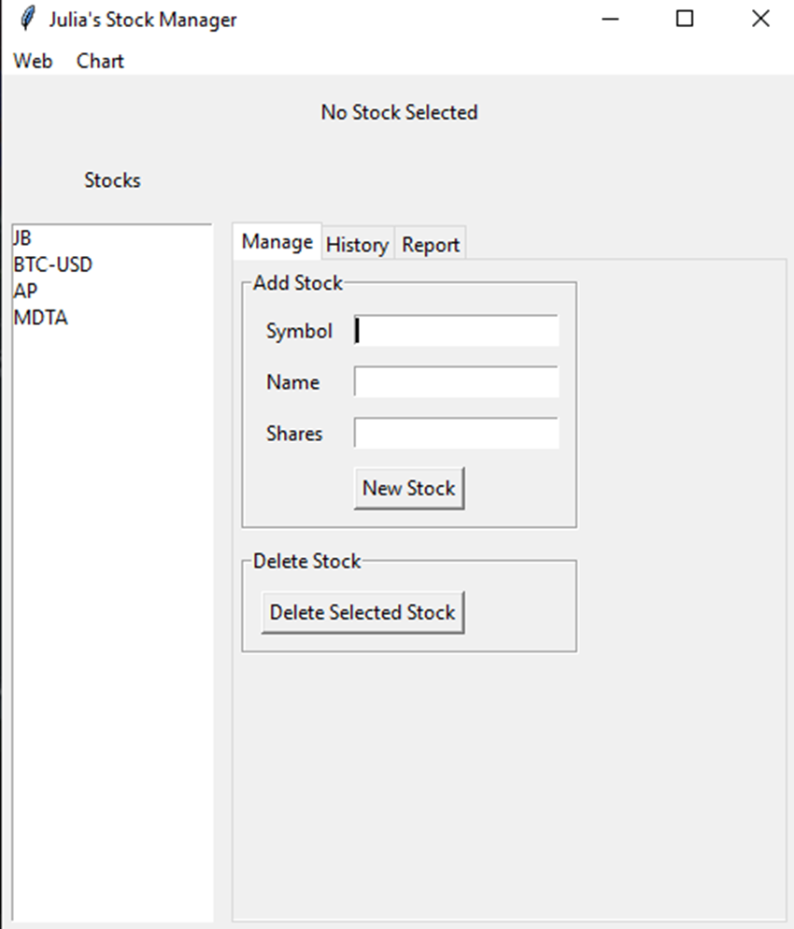
STOCKS IN GUI
AFTER WORKING OUT THE LOGIC AND FUNCTIONALITY OF OUR STOCK PROGRAM. USING THE TKINTER LIBRARY FROM PYTHON WE WILL CREATE A GUI INTERFACE.
USING THE SAME IMPORTED FILE FROM YAHOO. WE WILL USE INTO THE STOCK MANAGER’S GUI TO DISPLAY DATA AND COMPLETE A SUMMARY OF THE STOCK DATA.

Slide 17
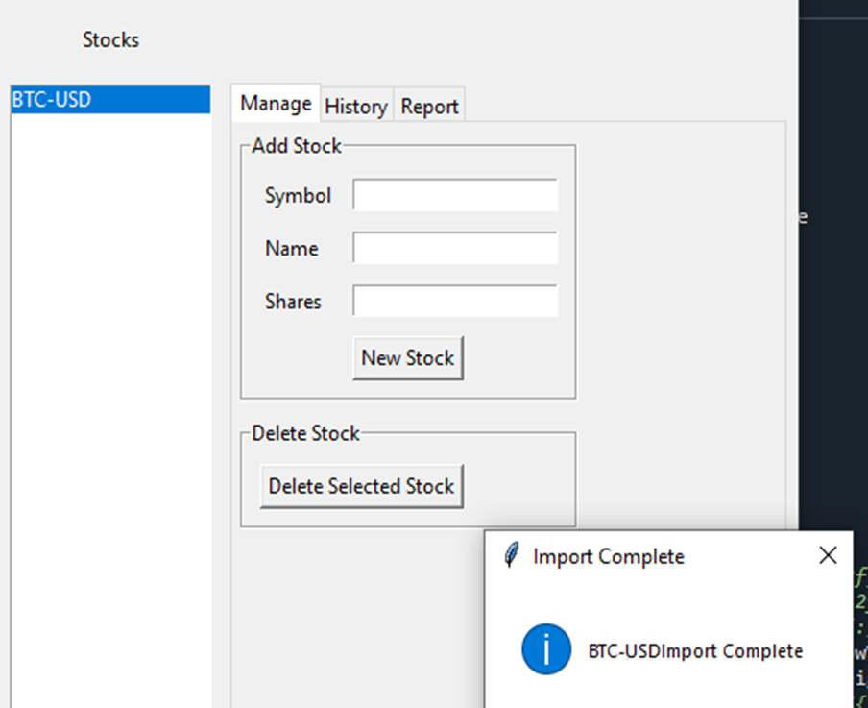
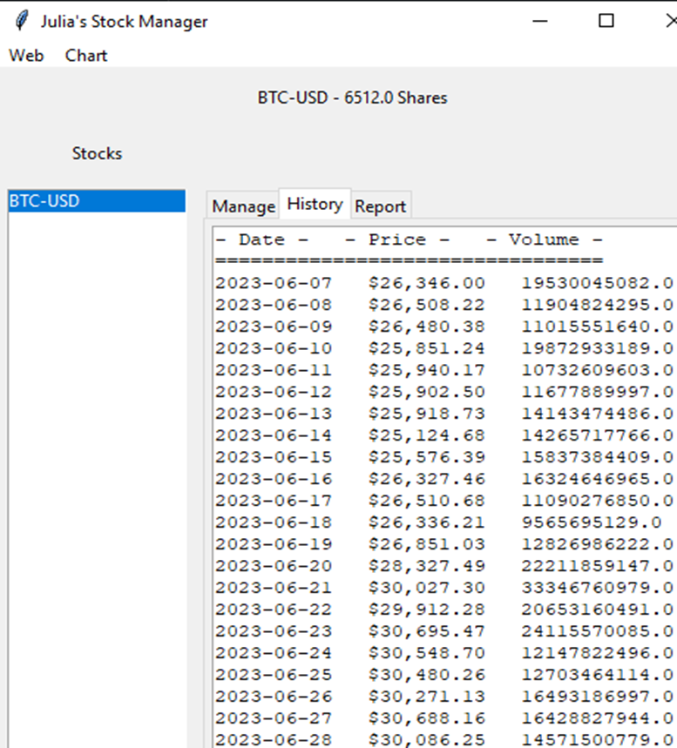
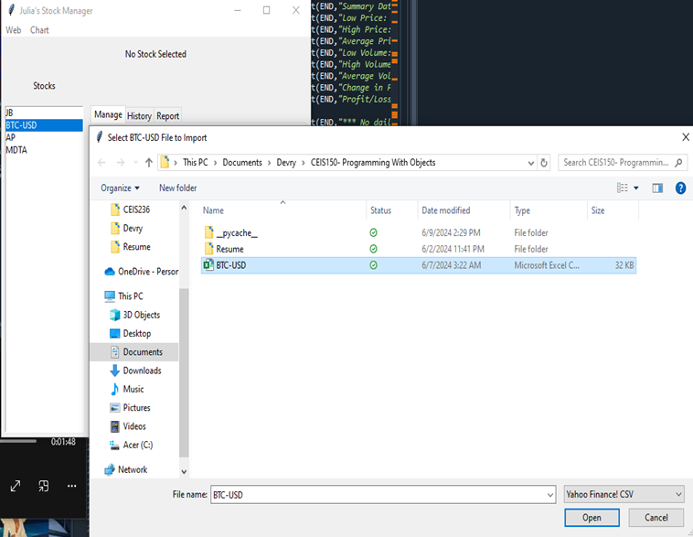
IMPORTING STOCK HISTORY

Slide 18
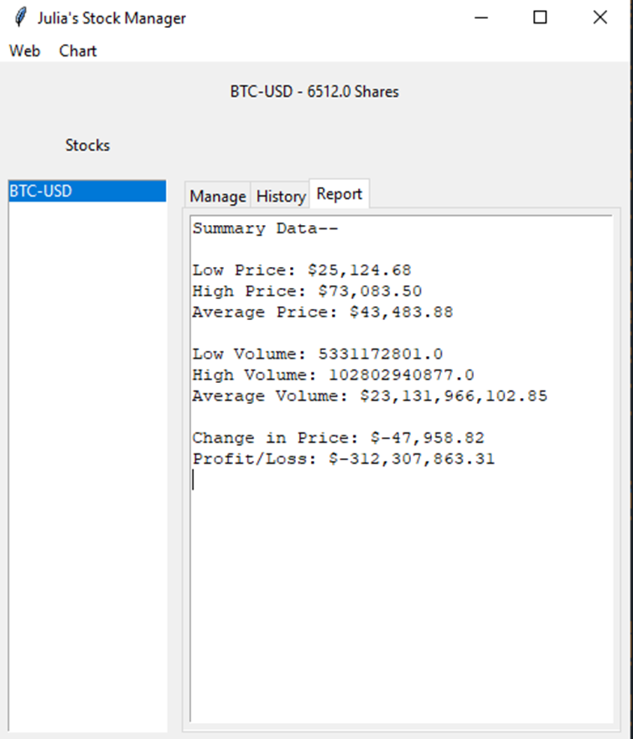
STOCK
REPORT

Slide 19

CAREER SKILLS DEVELOPED
DURING THE COURSE OF THIS PROJECT, I HAD THE OPPORTUNITY TO ENHANCE MY PROFICIENCY IN PYTHON AS WELL AS REFINE MY PROBLEM-SOLVING SKILLS, DEBUGGING TECHNIQUES, AN SOFTWARE DEVELOPMENT BEST PRACTICES. THESE SKILLS ARE NOT ONLY RELEVANT TO PROGRAMMING BUT ALSO DEMONSTRATE VALUABLE EMPLOYABILITY AND ADAPTIBILITY IN TODAY’S DYNAMIC JOB MARKET.

Slide 20

CONCLUSION
OBJECT-ORIENTED PROGRAMMING USING PYTHON WAS BOTH FUN AND CHALLENGING. IT ALLOWED ME AS A NEWLY DEVELOPER TO CREAATE A COMPLEX APPLICATION WITH EASE.
IT PROVIDED A STRUCTURED APPROACH TO SOFTWARE DEVELOPMENT, MAKING IT EASIER TO MANAGE COMPLEXITY, ENHANCED CODE REUSABILITY AND IMPROVE MAINTAINABILITY. DOING THIS BY MODELING REAL WORLD ENTITIES AS OBJECTS.

Slide 21






Thank you
Honor society since 10.2023
johnsonjulia198@yahoo.com
https://junieb904.wixsite.com/julia-johnson
Data mining & analytics 2024
240-431-9430
Information technology & networking –specialization in big data: 2025

