Slide 1

CEIS 114
SMART TRAFFIC LIGHT CONTROLLER
Julia Johnson
Professor Gusteau Duclos
Session: January 2025

Slide 2
Introduction
In today’s rapidly evolving world of smart technologies, the IoT is revolutionizing how we design and manage urban infrastructure. For this project, I had the opportunity to dive into the development of a smart traffic light controller- an essential component for modern cities facing challenges like traffic congestion, pedestrian safety, and emergency vehicle prioritization. Using Wokwi Lab, I designed a two-way intersection traffic light system featuring a pedestrian crossing with an LCD display and an emergency override signal. Throughout the process, I explored the integration of IoT functions, microcontroller programming with the ESP32, and real time decision making through sensor input. This hands-on experience not only deepened my understanding of traffic engineering principles but also introduced me to the practical skills required to build smarter, safer, and more responsive urban transportation systems.

Slide 3
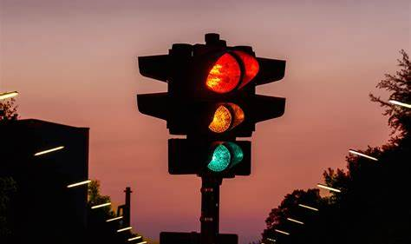
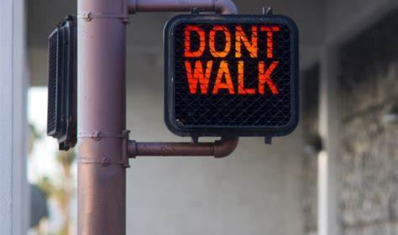
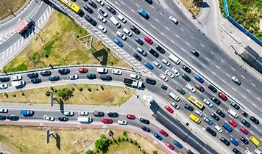
Agenda
Module 2, Setting up the Environment
Module 3 , Creating the Traffic Controller using Wokwi
Module 4, Creating a Multiple Traffic Light Controller
Module 5, Multiple Traffic Light Controller with Cross Walk
Module 6, Traffic Light Controller, Cross Walk, Buzzer, LCD Display
Module 7, IOT Access
Challenges
Career Skills
Conclusion
Links

Slide 4
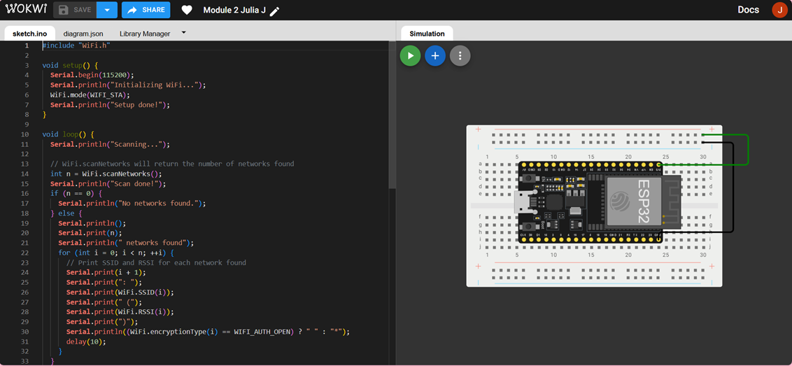
Module 2
Setting up the environment
In the first week, I focused on setting up my environment to start building the smart traffic light system. I began by signing up on the Wokwi platform, where I was able to simulate and test my IoT circuits. I connected the ESP32 to the breadboard and made sure power was properly set up by wiring the GND and 3.3V pins. After the physical layout was completed, I moved on to the coding portion. From here I added a simple Wi-Fi scan script to test the ESP32, to search nearby networks and display them in the serial monitor. Running the simulation helped me confirm that the ESP32 was wired and coded correctly. This set up laid the groundwork for integrating more components in the coming weeks.

Slide 5
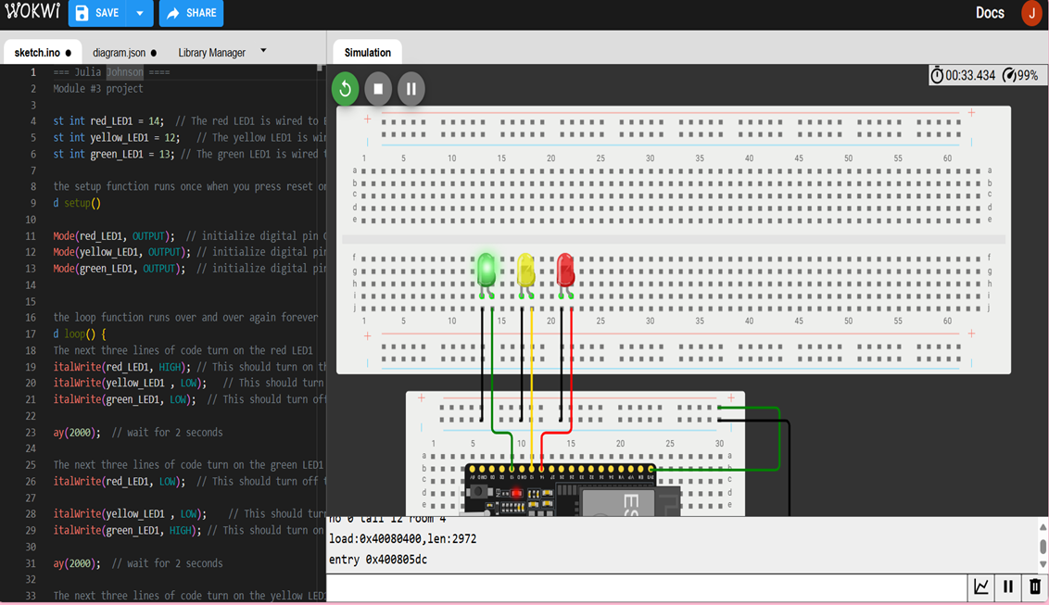
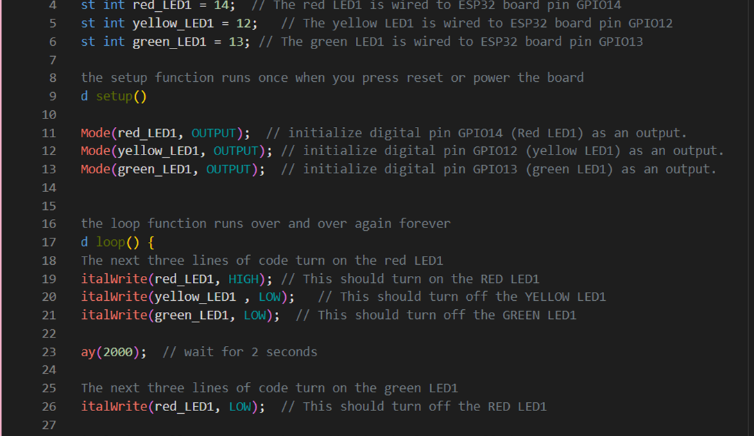
Module 3
Creating the traffic controller
The next step in this project is to develop a Multi-intersection Traffic Light System using Wokwi Lab and the ESP32 microcontroller.
A Single traffic light was simulated by connecting red, yellow and green LEDs to GPIO pins (14, 12, and 13) on the ESP32. using Wokwi, I built the circuit with breadboards and virtual wires and wrote code to cysle the lights using digitalwrite() and delay(). The simulation successfully mimicked a real traffic signal, laying the foundation to add more advanced features to come.

Slide 6
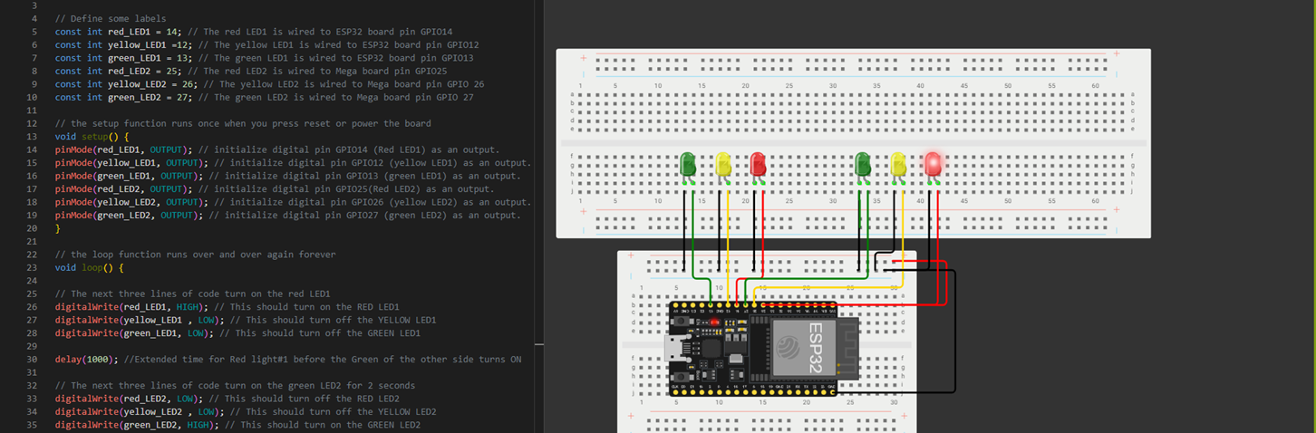
Module 4 creating a multiple traffic light controller
This week Ive expanded my simulation by introducing two sets of LEDs to represent two intersecting roads, with logic to alternate traffic flow for safety and efficiency. I connected the additional LEDs to GPIO25(Red), GPIO26(Yellow), and GPIO27 (Green), simulating the second intersection. The code was updated to control both intersections, alternating signals with realistic timing.

Slide 7
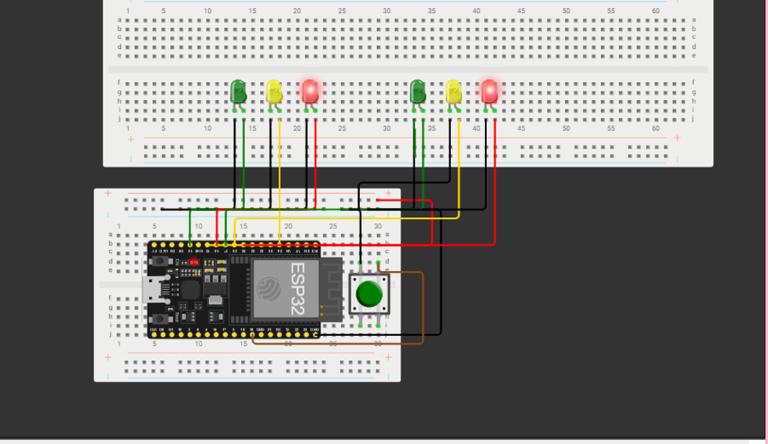
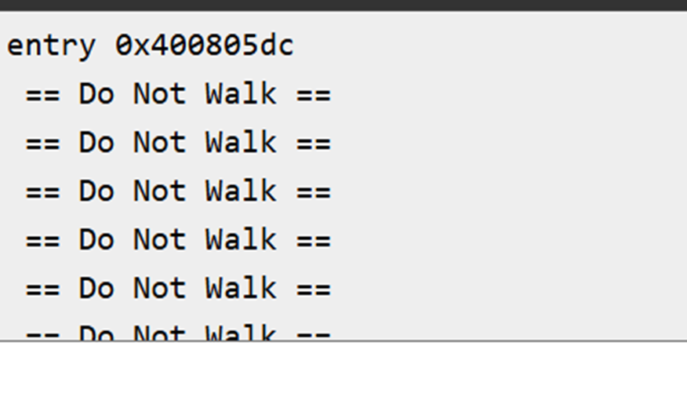
Module 5 multiple traffic light controller with cross walk
The focus was on designing a simulating a smart multi- intersection traffic light controller with pedestrian crossing functionality. The system included two sets of traffic lights, a pedestrian crosswalk button, and an emergency override that activated flashing red lights and blue alert signal. When the button was pressed, the system halted vehicle traffic and displayed a countdown in the serial monitor, allowing pedestrians time to cross.

Slide 8
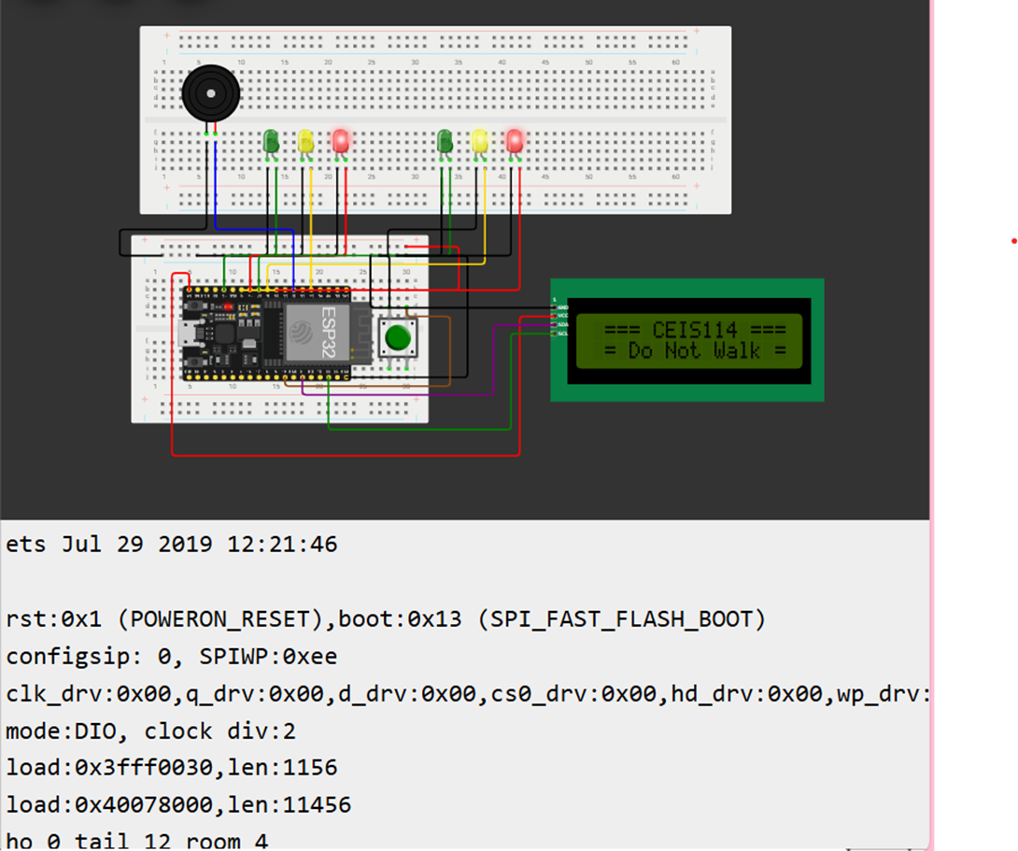
Module 6 traffic light controller, cross walk, buzzer, lcd display
The pedestrian system displays walk instructions and counts down from 15 to 0, while the emergency feature forces all lights to red and activates a flashing blue light. Using the LiquidCrystal_I2C Library to manage LCD output.

Slide 9
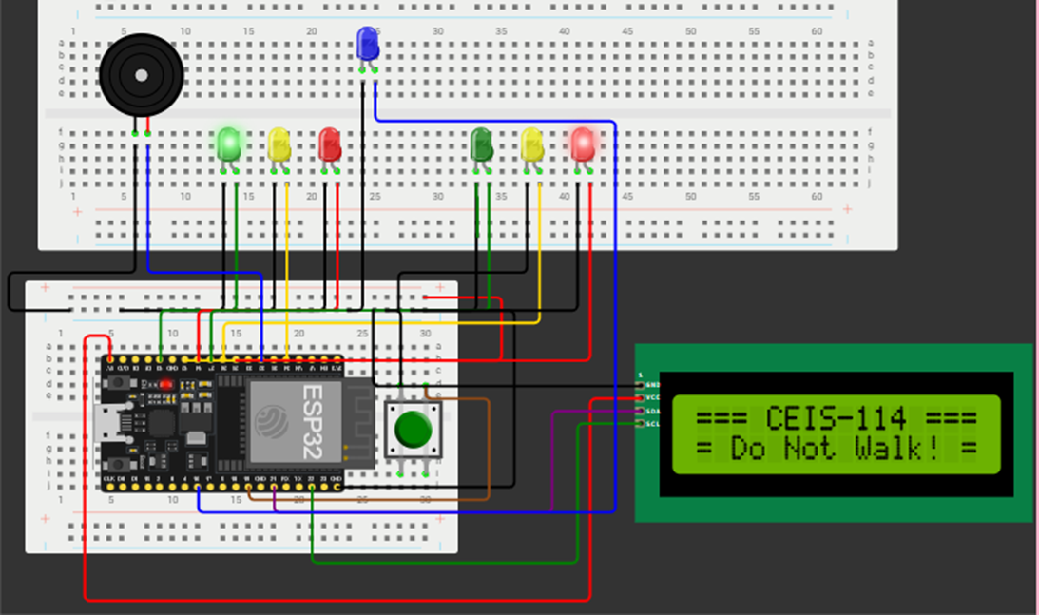
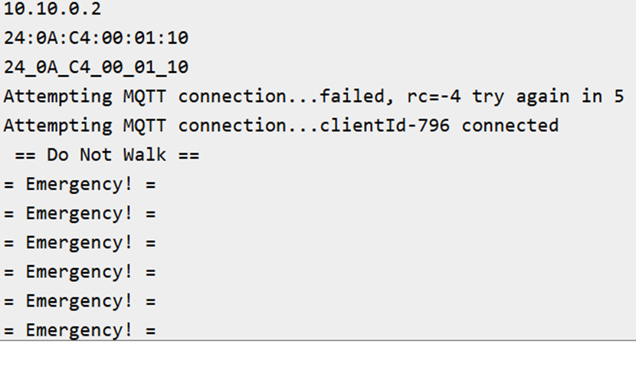
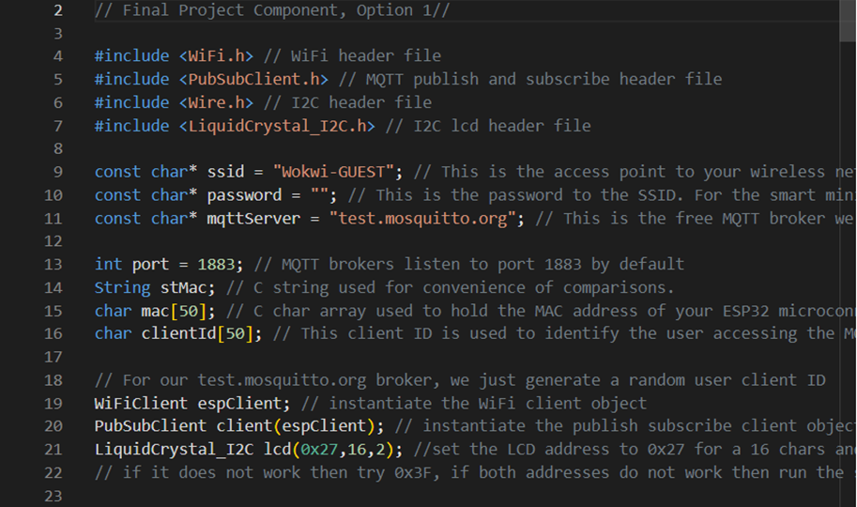
Module 7
Iot access
The focus was on integrating and testing the LCD display using the LiquidCrystal_I2C-master library within the Wokwi Simulation environment. A custom LCDScreen class was developed to manage the display of real time traffic and crosswalk status.

Slide 10
Challenges
Setting up MQTT communication for real time IoT access required proper configuration of topics, broker connections, and message handling, which can be challenging to debug.

Slide 11
Career skills
Creating the Multiple Traffic Light Controller helped me to develop several valuable career skills, including embedded system programming, circuit design, and IoT integration using MQTT protocols. It strengthened skills in real-time system design, multitasking with timing sensitive elements and debugging complex microcontroller interactions. The project also enhanced proficiency in coding for microcontrollers, working with hardware simulation platforms like Wokwi.
Embedded Systems
IoT Development
Explore new techniques
Circuit Design
Programming

Slide 12
conclusion
This project was very fun to work with and demonstrate a strong understanding of embedded systems, IoT integration, and real-time control systems. It showcases the ability to design and implement a fully functional traffic light control system, integrating various hardware components (traffic lights, crosswalk, buzzer, LCD display) and software protocols. This project highlights technical problem-solving skills, the ability to work with hardware and software simultaneously, and a solid grasp of using simulation tools like Wokwi for prototyping.

Slide 13
Thank you
Julia Johnson
Home | Julia Johnson
johnsonjulia198@yahoo.com
linkedin.com/in/julia-johnson-a35697258/

