Slide 1

Weather data analysis

Slide 2
agenda
Introduction
Software Installation
Planning/ Flowchart
Downloading Weather Data
Python Console
Weather.db File
Querying the Database with SQL
Query to retrieve lowest and highest temperatures
Query to retrieve all clear days
Querying & Manipulating Data with SQL & Python
Retrieve & Convert Data to CSV Format
Develop Graphical Models & Interpret Results
Plot 2
Analysis
Prediction
Challenges
Career Skills
Conclusion

Slide 3
Introduction
This Project focuses on data analysis using Python. Each section builds upon the project resulting in an analysis of weather data downloaded from a cloud data source, stored in a database, extracted and processed. This process will include planning, software setup, and programming.

Slide 4

Software Installation
Software Used to complete this project: Excel, Python (Replit), Powerpoint

Slide 5
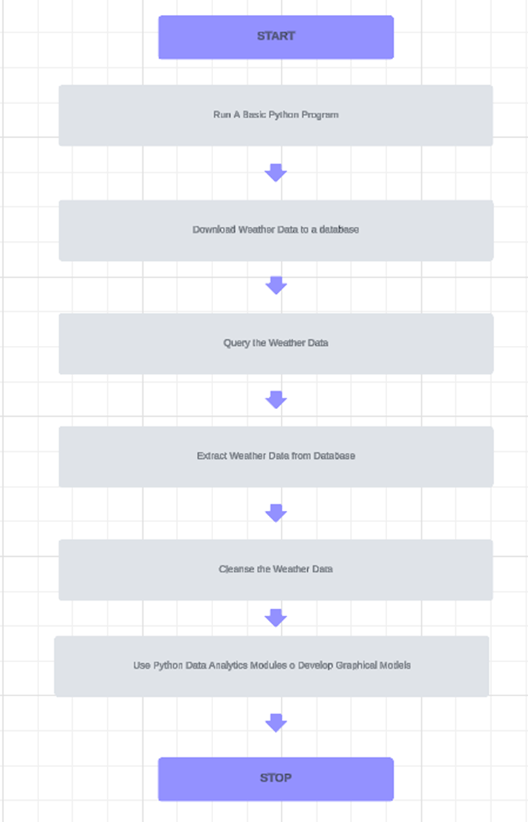
Flowchart
To begin I start by creating a flowchart for the inputs/ processing/ output for the weather data analysis system. Using the flowchart allows me to check and verify the logical process for the problem.

Slide 6
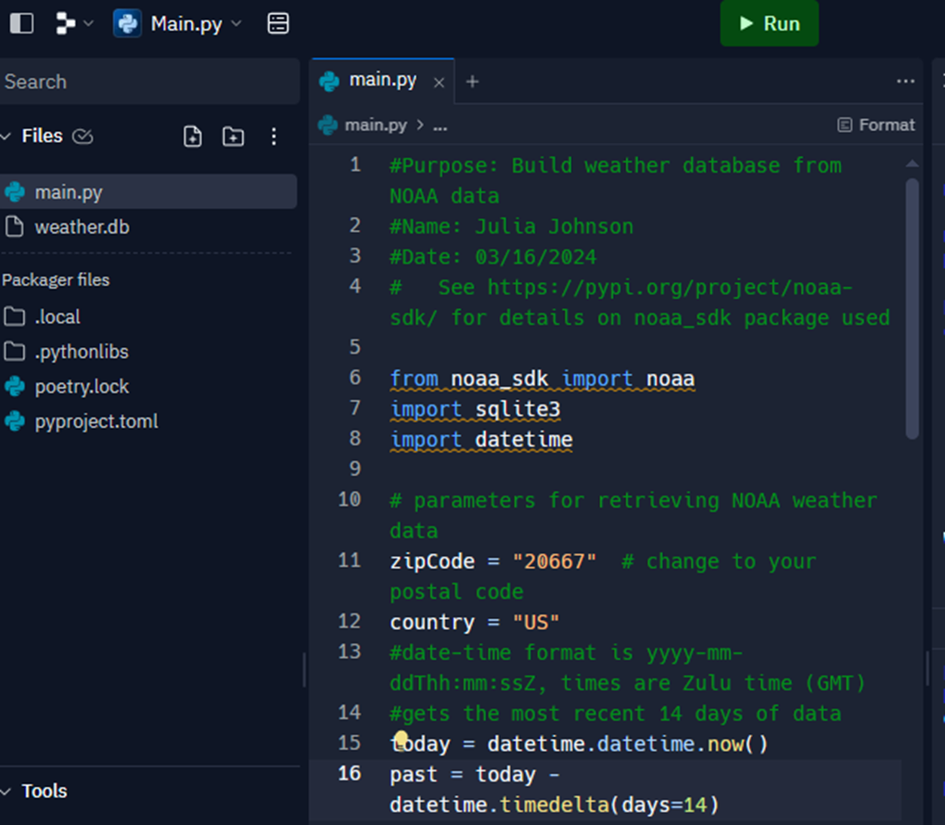
Downloading weather data
The US National Oceanic and Atmospheric Administration (NOAA) provides free access to nationwide weather observation via a cloud-based Application Programming Interface. With this I was able to create and run a Python program to download a data set of recent weather observations for my location. My Python program will create a database onto my computer’s hard drive and store the weather data in a table to use analysis .

Slide 7
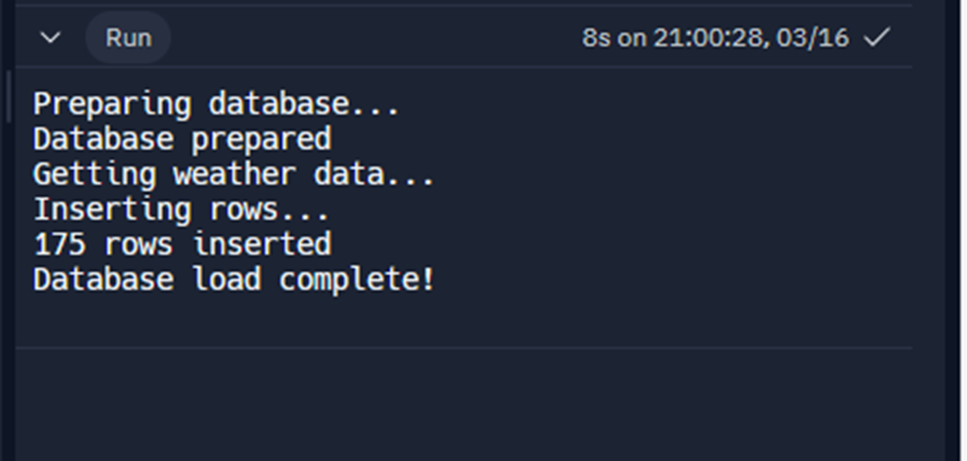
Python console
Program Output in Python console showing program was executed Successfully

Slide 8
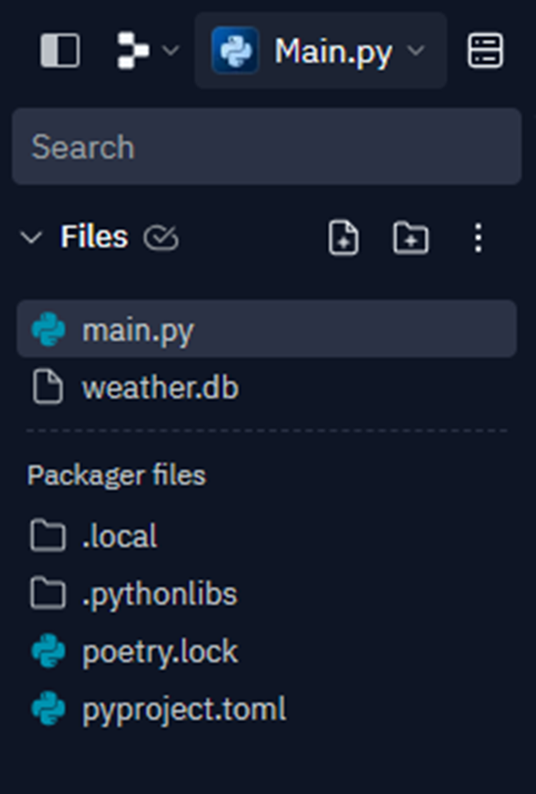
Weather.db file
Database file Weather.db was created

Slide 9
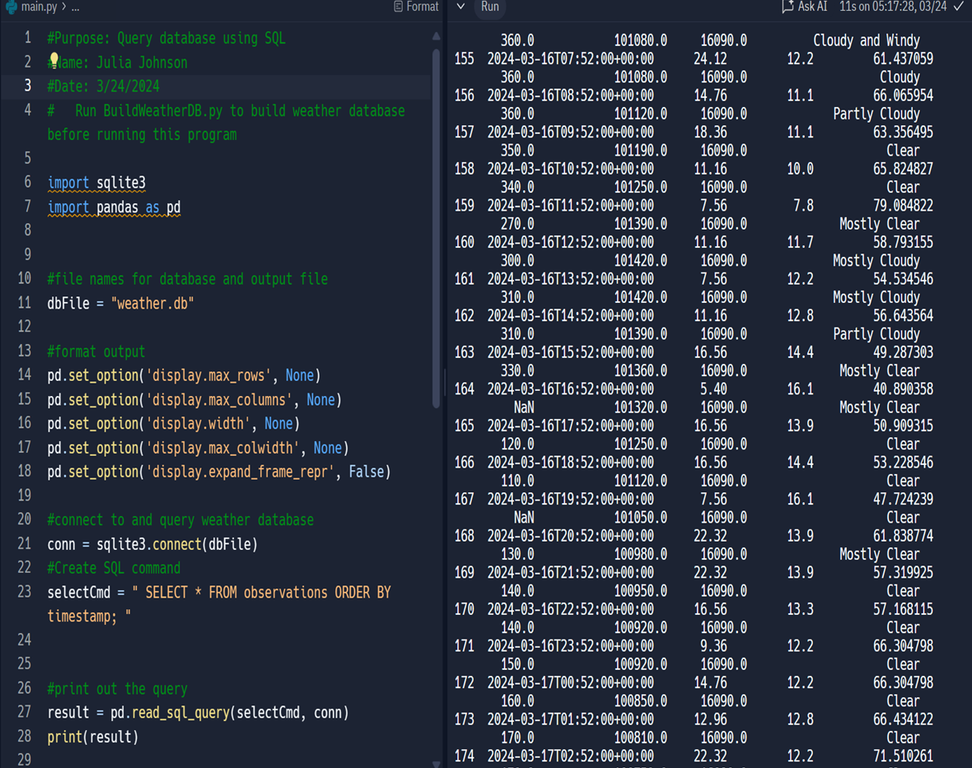
Querying the database with sql
During this process of the project, I use Python to issue SQL query commands to my database and receive and display results. First Query to retrieve all columns and all rows.

Slide 10
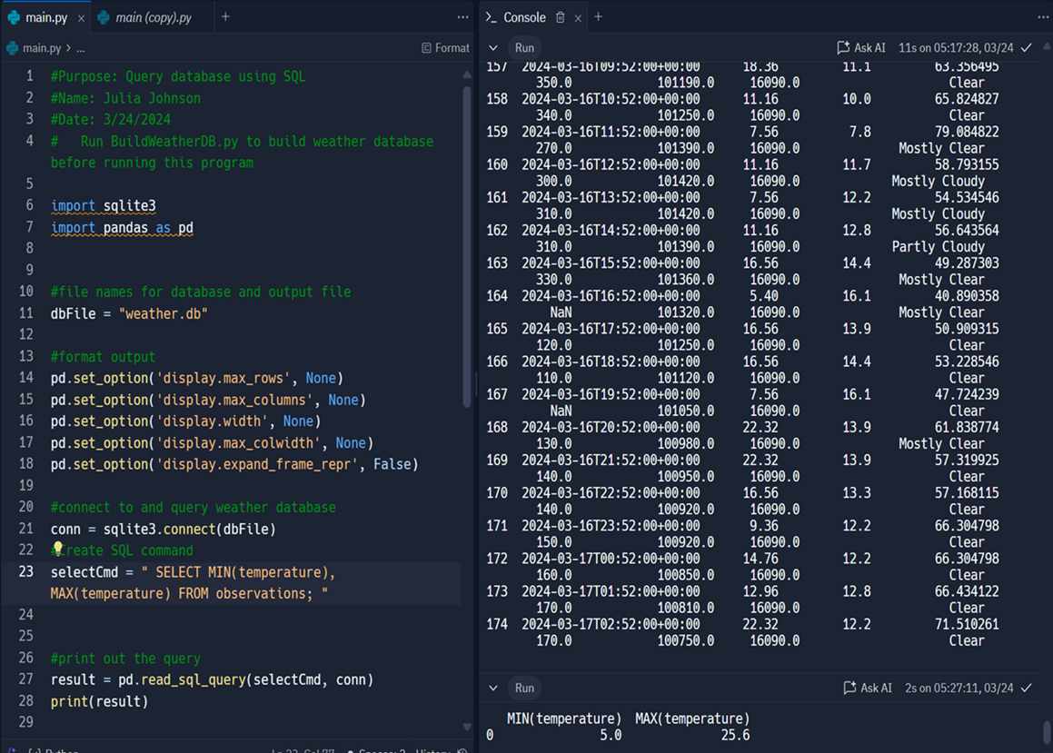
Query to retrieve lowest and highest temperature

Slide 11
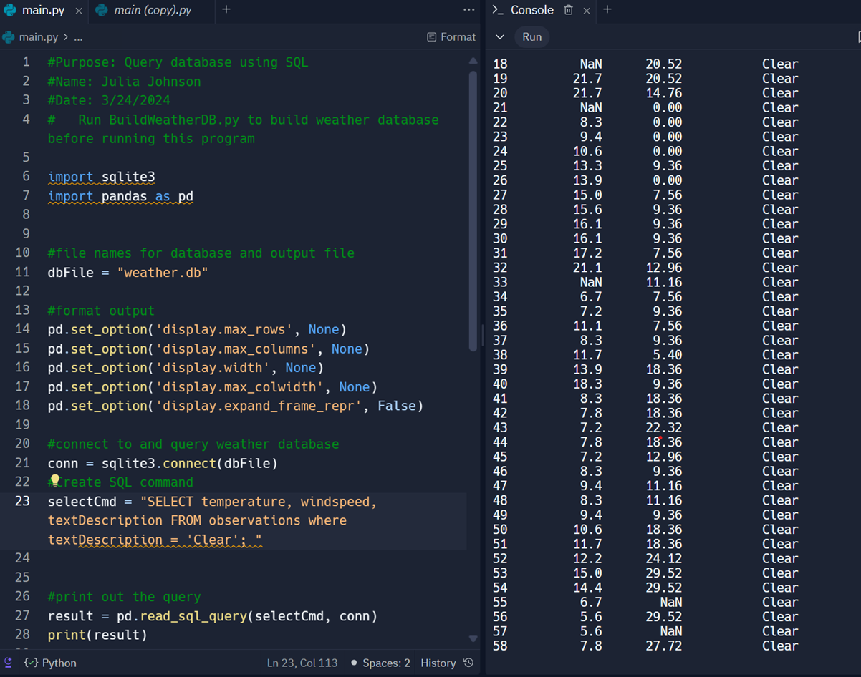
Query to retrieve all clear days

Slide 12
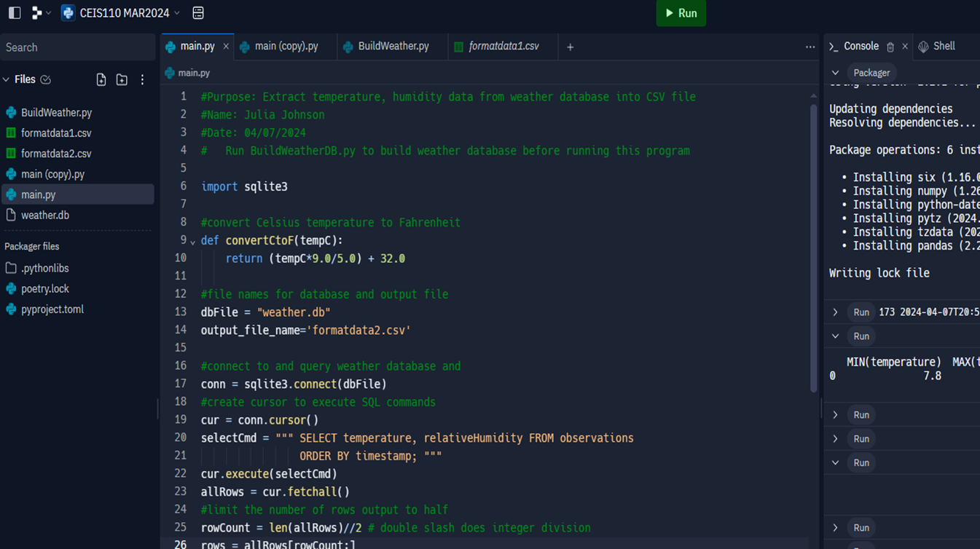
Querying & manipulating data with sql & python
The data in the database must be cleansed so that the missing data and spurious can be removed. This is done to ensure the data is complete, valid and standardized. This screenshot shows the python code used to extract TempHumidity and from there we will cleanse the data.

Slide 13
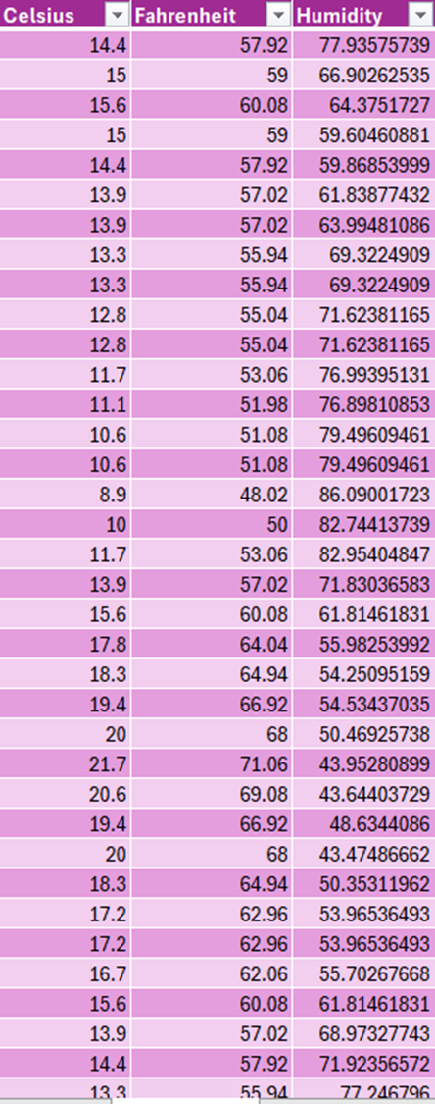
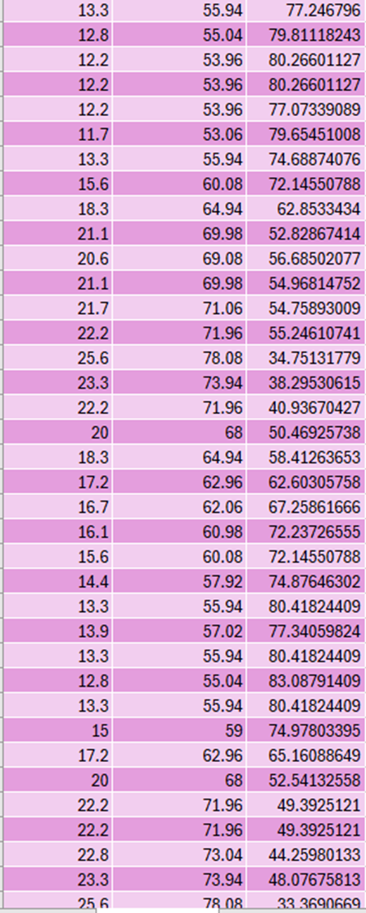
Retrieve & convert data to csv format

Slide 14
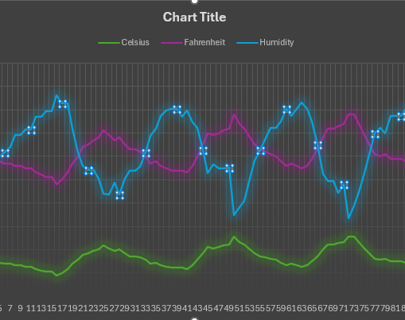
Temperature & humidity chart
It seems that temperature and humidity have an inverse relationship. When the temperature rises, the humidity decreases. Although there are rare instances during the week where both high temperature and high humidity are observed, this is not the norm.

Slide 15
Graphical models & interpret results

Slide 16
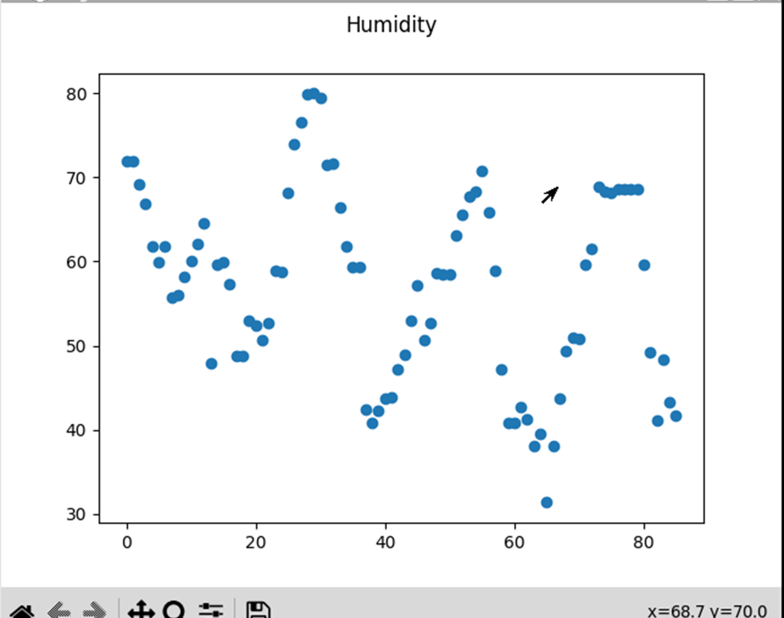
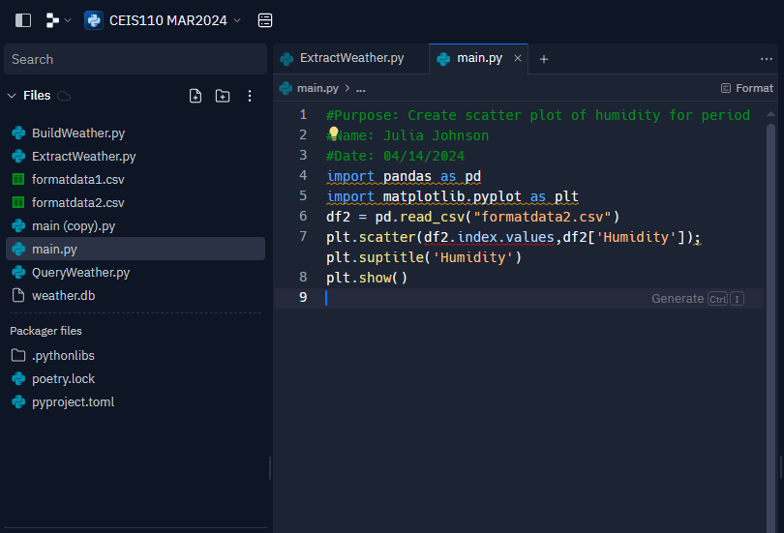
Plot 1

Slide 17
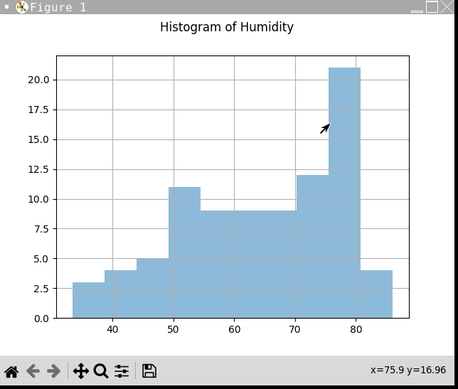
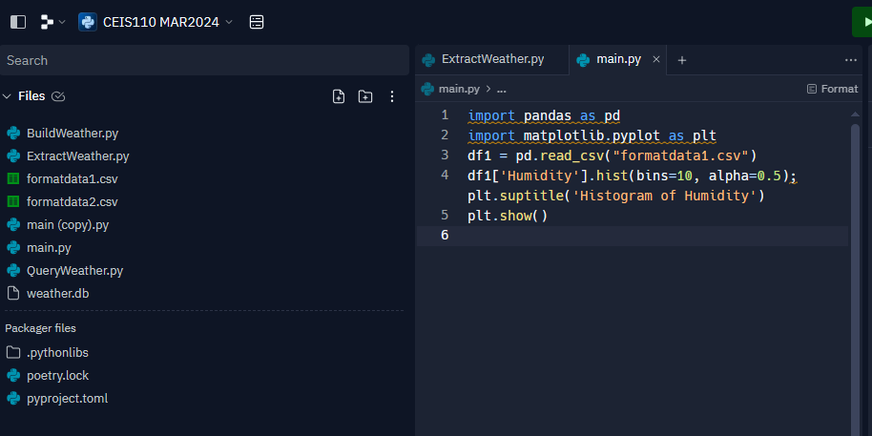
Plot 2

Slide 18

analysis
1.When is it usually the warmest time of the day?
Early afternoon.
2.Is the relative humidity usually higher or lower at this time, compared to the rest of the day?
Lower when the temperature is high.
Warm air has the potential to hold more water vapour than cool air.
If the moisture in the air remains unchanged and the temperature rises, the maximum amount of moisture that the air could hold increases. The numerator is the same and the denominator is increased, so the resulting percentage will be lower

Slide 19
prediction
According to the data provided, it is expected that the rise in temperature over the next few days will result in an increase in humidity levels. The average humidity level, which is currently at 8.75, is projected to rise with the increase in temperature. This prediction is based on the analysis of the current mean shown in the chart.

Slide 20

Challenges
Despite encountering a few challenges throughout this project, I was able to overcome them with confidence and perseverance. I successfully set up the work environment and selected the best program for running Python that was compatible with my computer. While I did encounter syntax errors, indentation issues, and unexpected behaviors such as chart loading and running errors, I approached these with a positive attitude and was able to resolve them quickly. Overall, navigating these challenges was a testament to my skills and determination.

Slide 21

Career Skills
Completing this course project has helped me acquire valuable career skills such as designing a prototype software system, creating a relational database, and downloading data from the cloud using APIs. I have also learned how to retrieve data from a database using embedded SQL queries in Python. These skills have equipped me with the ability to interpret and analyze data effectively.

Slide 22
conclusion
I have thoroughly enjoyed working with Python, and the experience has been both fun and challenging. The easy-to-learn syntax of the program made it simple for me to read and understand, which in turn allowed me to confidently build upon each section of my project. Using Python, I was able to demonstrate my ability to successfully download, extract, and process data, and perform a thorough analysis using simple yet effective programming techniques. Overall, I am extremely pleased with my accomplishment and my newfound confidence in my programming abilities.

Slide 23

Thank you
Julia Johnson
johnsonjulia198@yahoo.com
https://junieb904.wixsite.com/julia-johnson

